Slide 1
Guide for Customer Onboarding
Bernice Templeman

Slide 2
Agenda
Overview
FRS
Instance
Domain separation
Admins
Create domain and sub-domains
Create a company for each domain
Select domain
Create and select update set
Excel Data file
Load/create map/ transform each Excel sheet
Create schedules and Holiday schedule
Override/create SLAs
Complete Update set
Reflections
Questions

Slide 3
Overview
The Customer Onboarding project includes the entire details for the fresh customer to get onboarded on the multi-tenant instance including:
Domain
Company
Department
Locations
Users
Groups
Roles
Categorization, Resolution details, and SLA
using Import Sets and Transform Maps.
It also includes separate Requirement Design documents as per the industry best standards. Leverages Import Sets and Transform Map.

Slide 4
Create the FRS document
The Team Lead worked with the client to get the requirements and the entire team worked on the FRS.
Each team member was responsible for their child domain.
Team:
Phillip Caruthers
Samuel Hagadorn
Bernice Templeman
Malykai Mejia

Slide 5
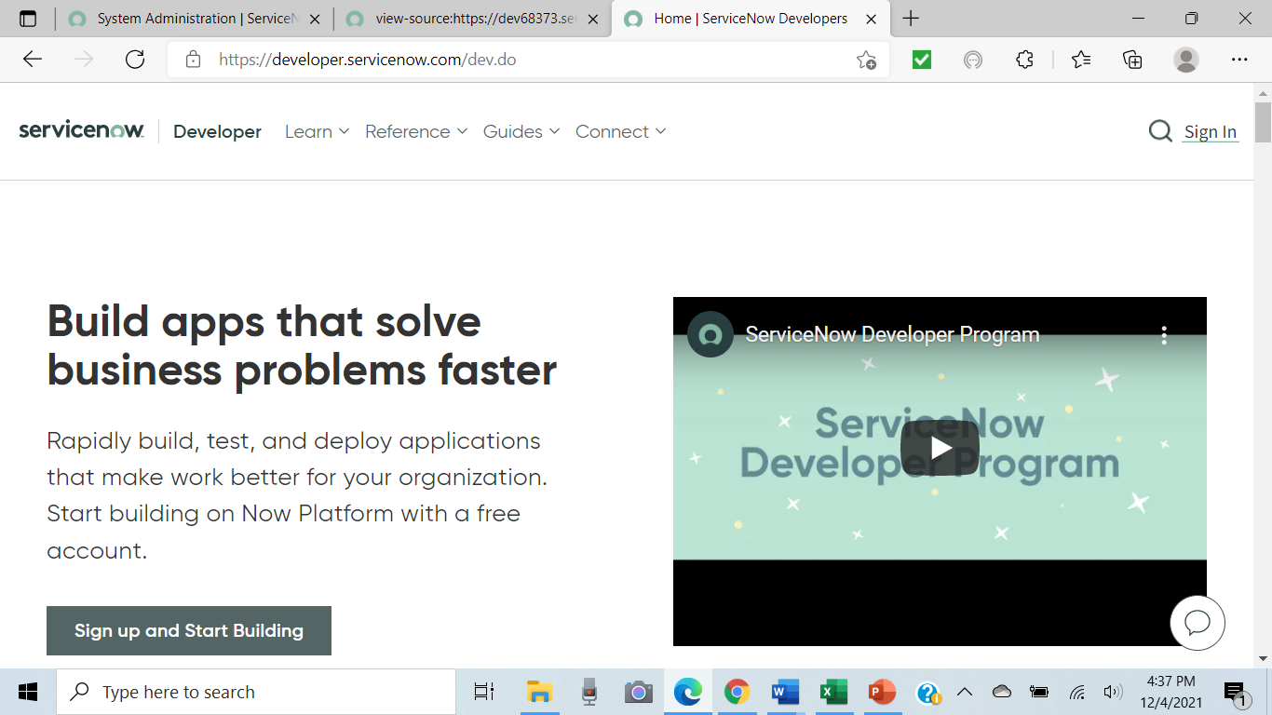
Create instance

Slide 6
Activate Domain Separation Plugin
Activated Domain Support - Domain Extensions Installer

Slide 7
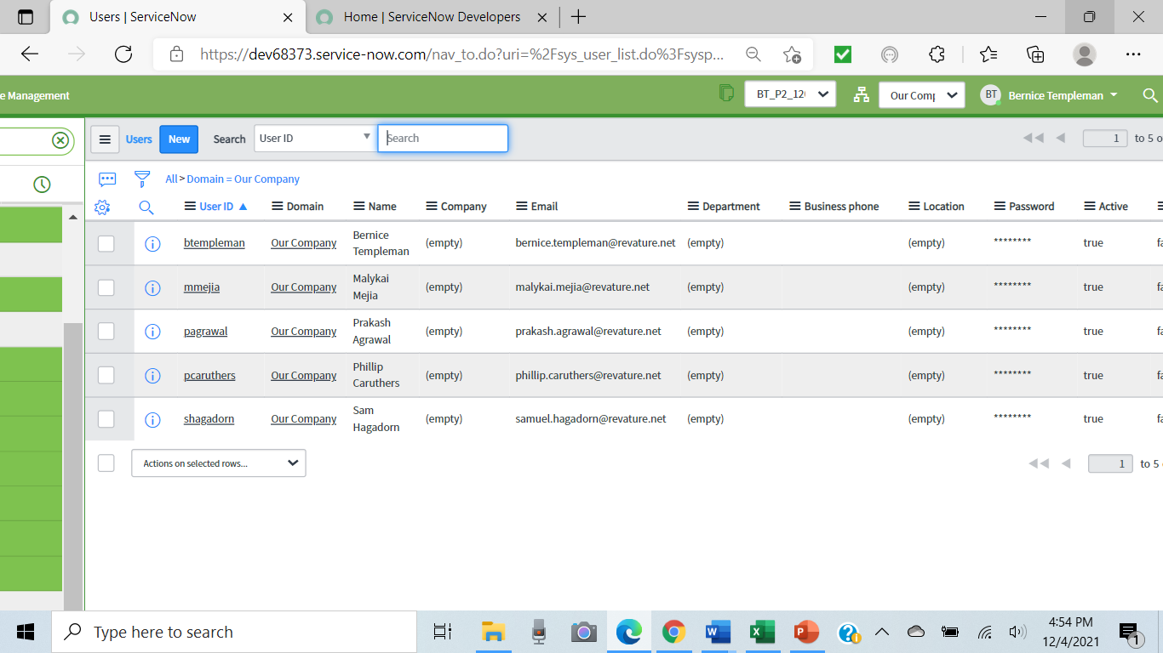
Create users with admin

Slide 8
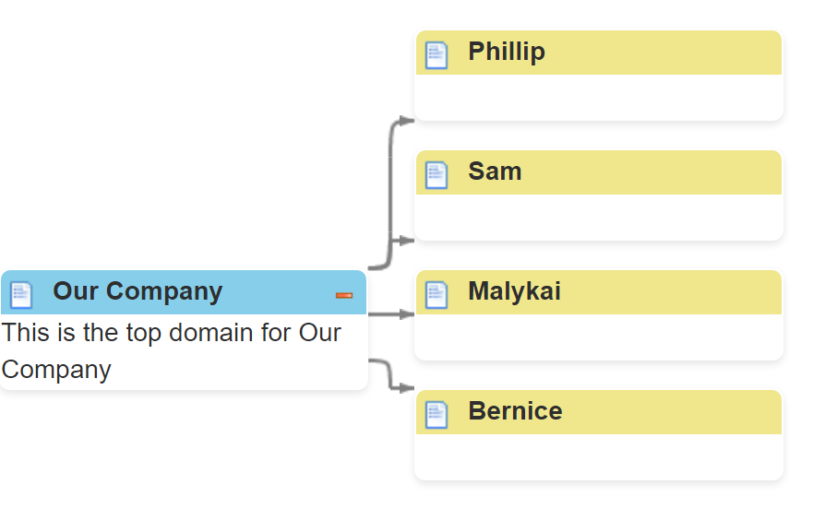
Create domain and child domains

Slide 9
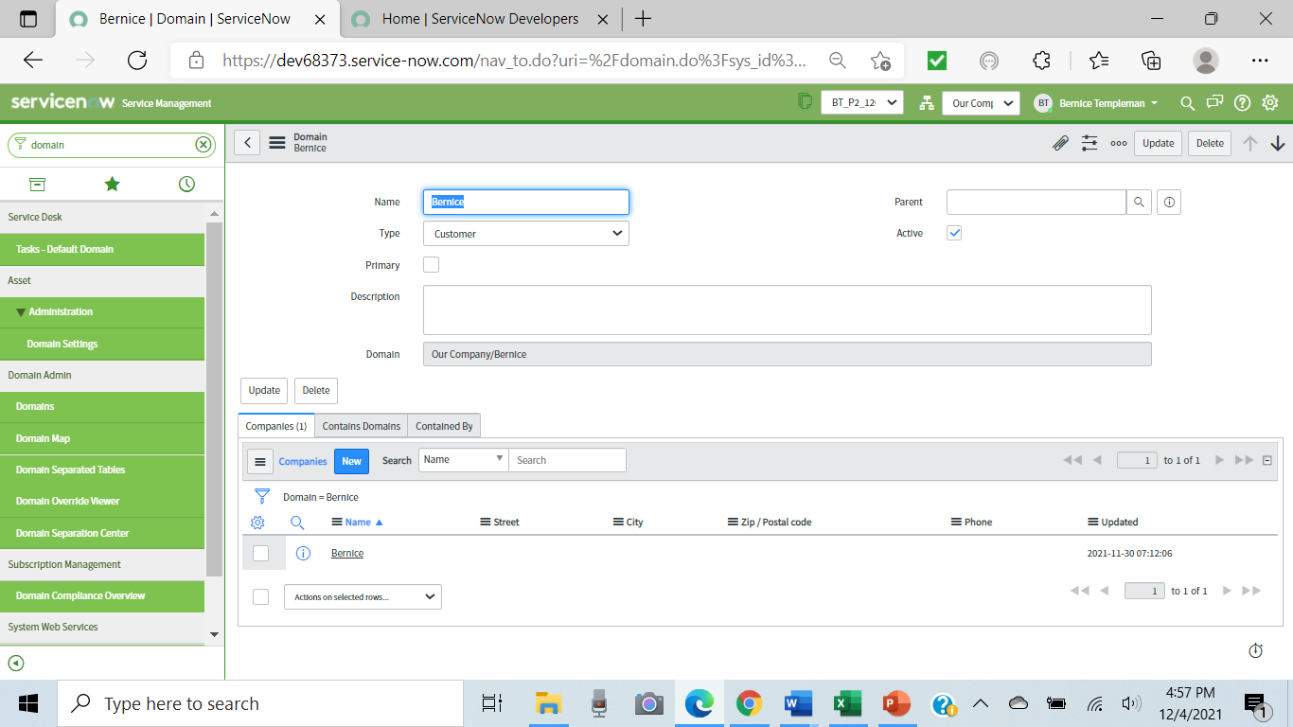
Create a company for each domain

Slide 10
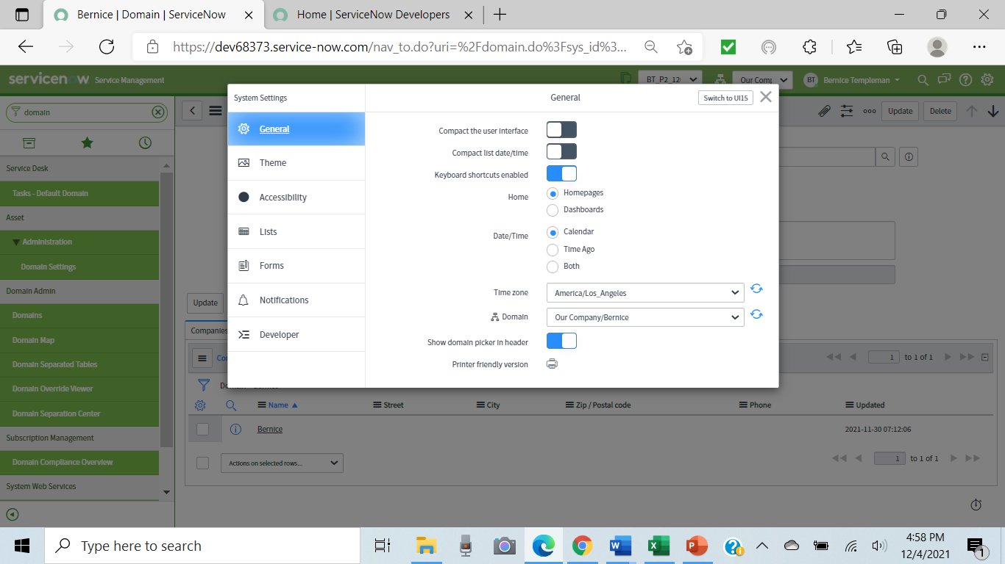
Add domain picker & Select domain

Slide 11
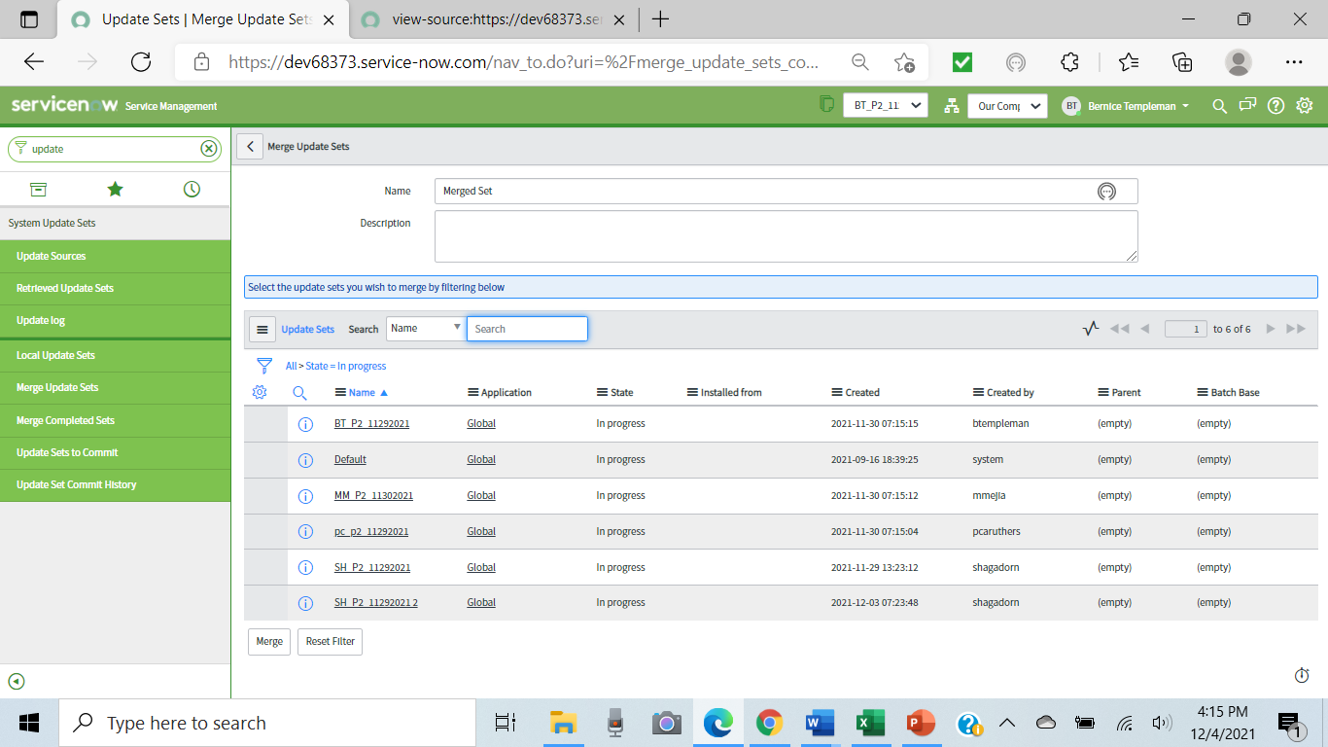
Create/Select update set

Slide 12
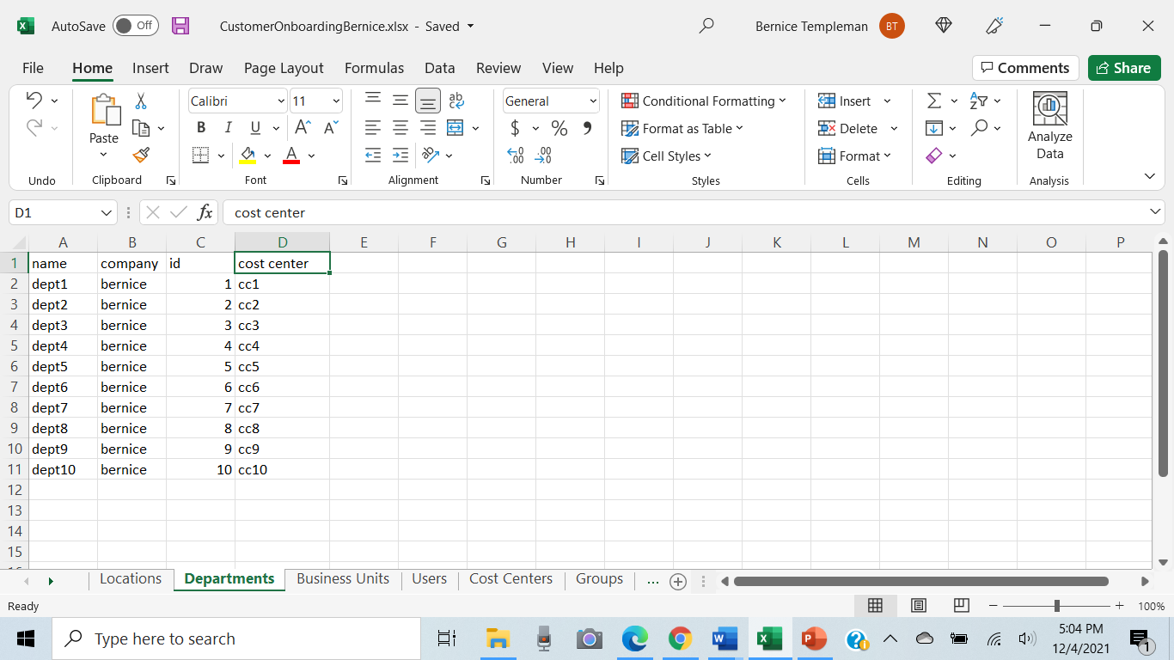
Excel data file

Slide 13
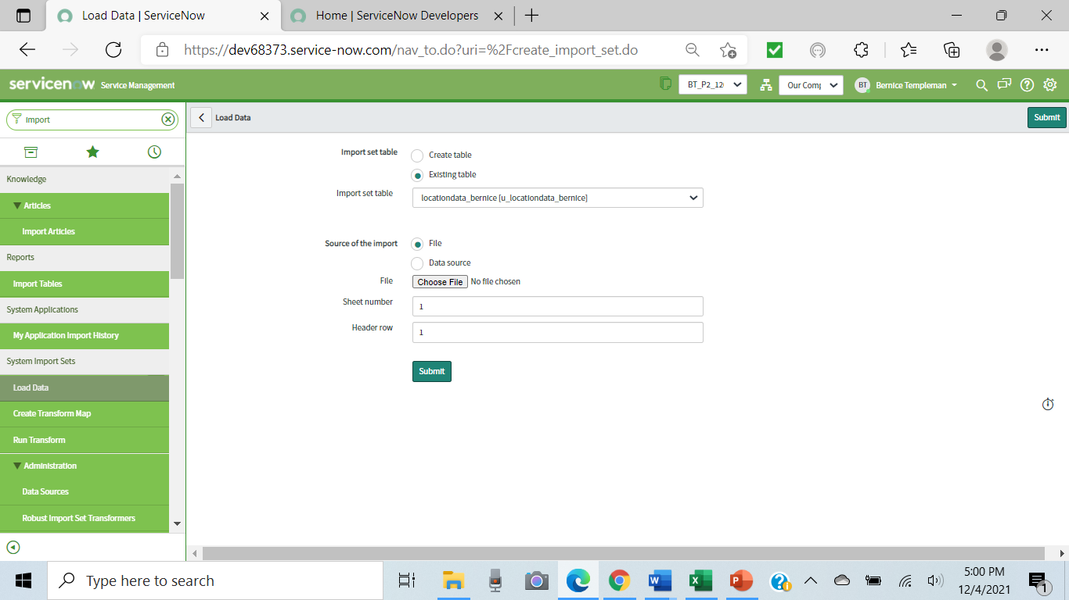
Load Data

Slide 14
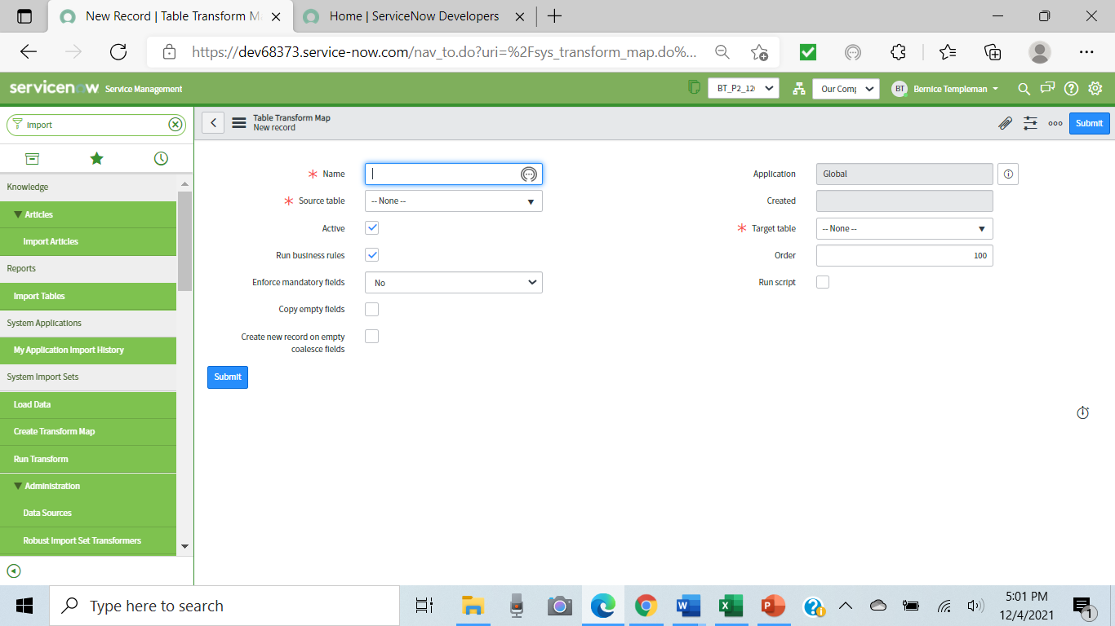
Create transform map

Slide 15
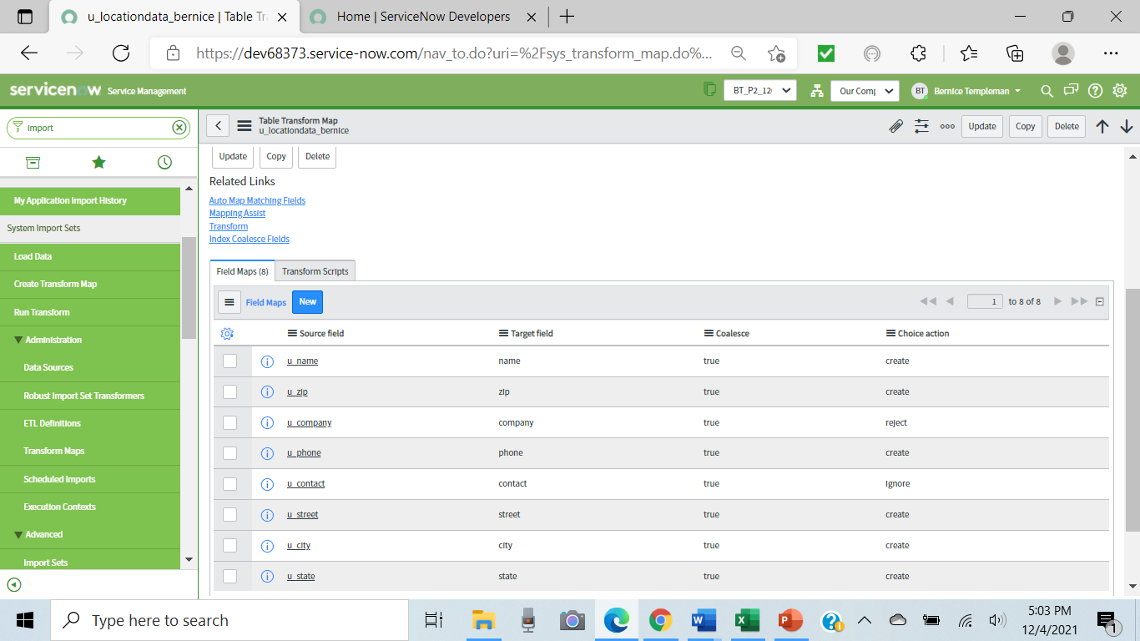
Set Coalesce and Choice action

Slide 16
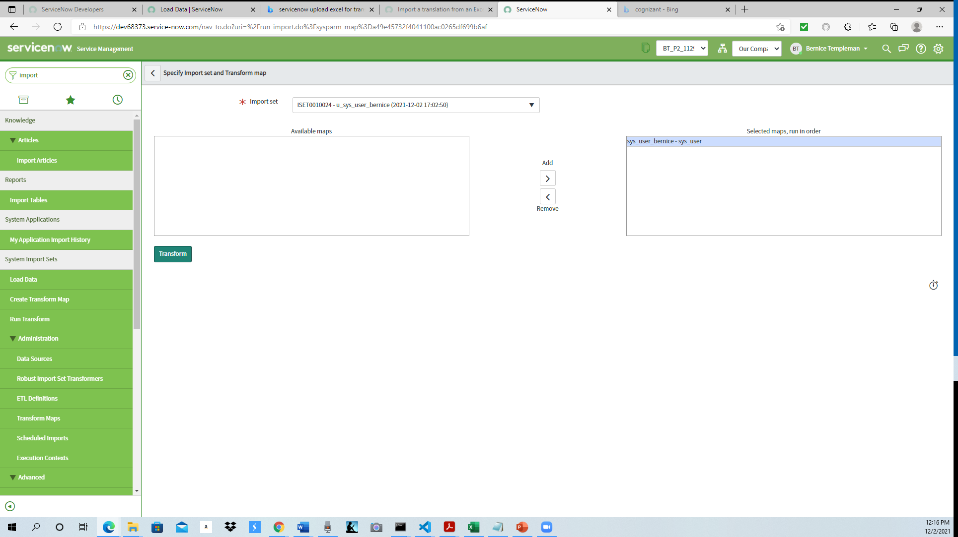
Transform

Slide 17
For each Excel Sheet: Load/create transform map/ transform

Slide 18
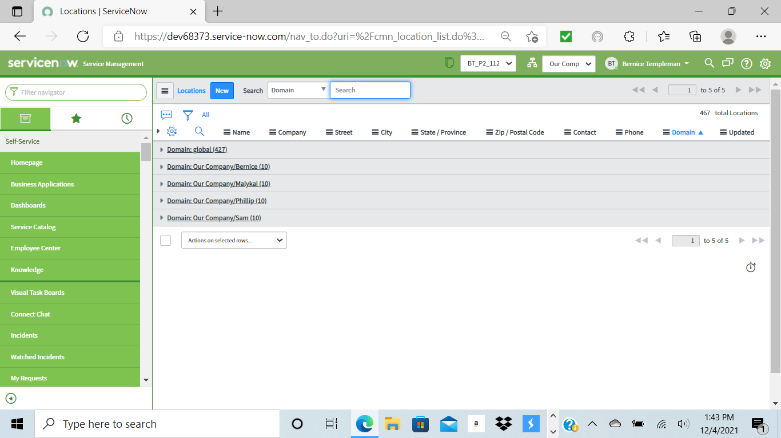
All Locations: cmn_location

Slide 19
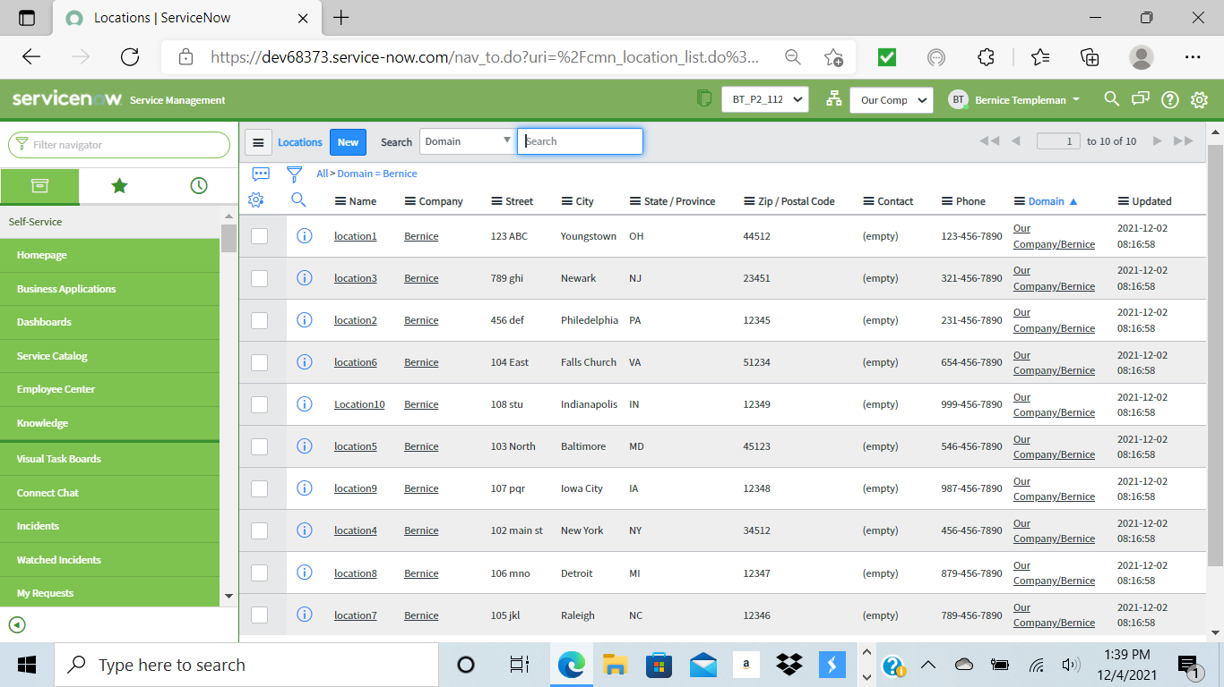
Locations for Bernice

Slide 20

All Departments: cmn_department

Slide 21
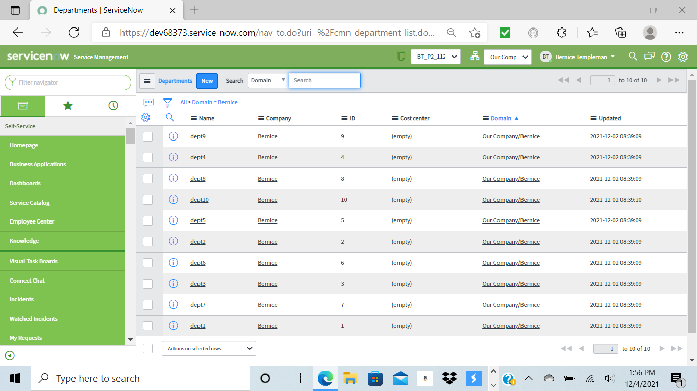
Departments for Bernice

Slide 22
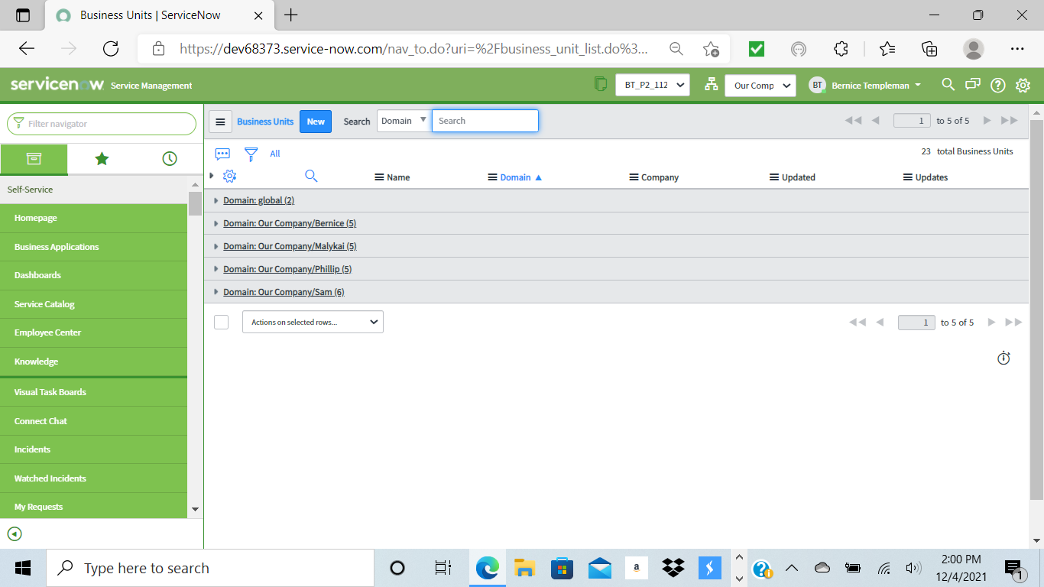
All Business Units: cmn_cost_center

Slide 23
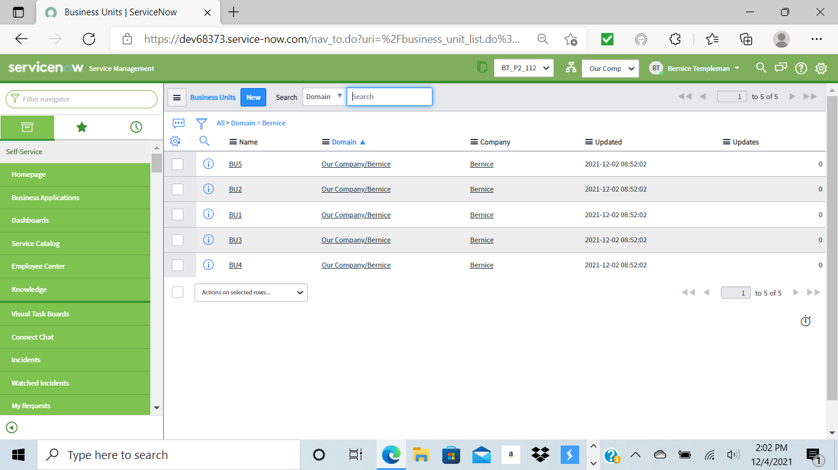
Business Units for Bernice

Slide 24
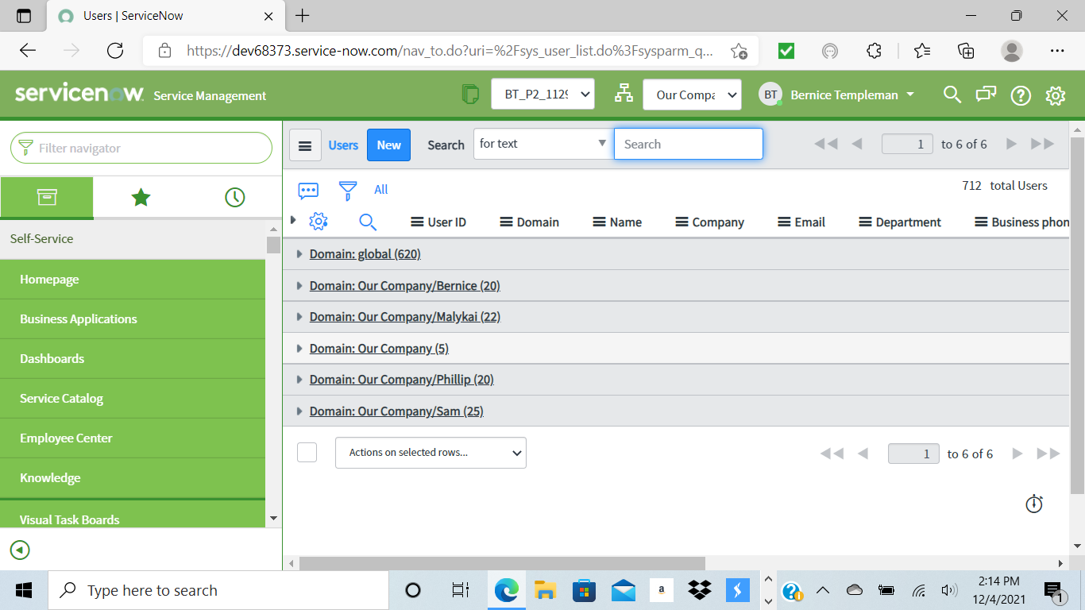
Users: sys_user

Slide 25
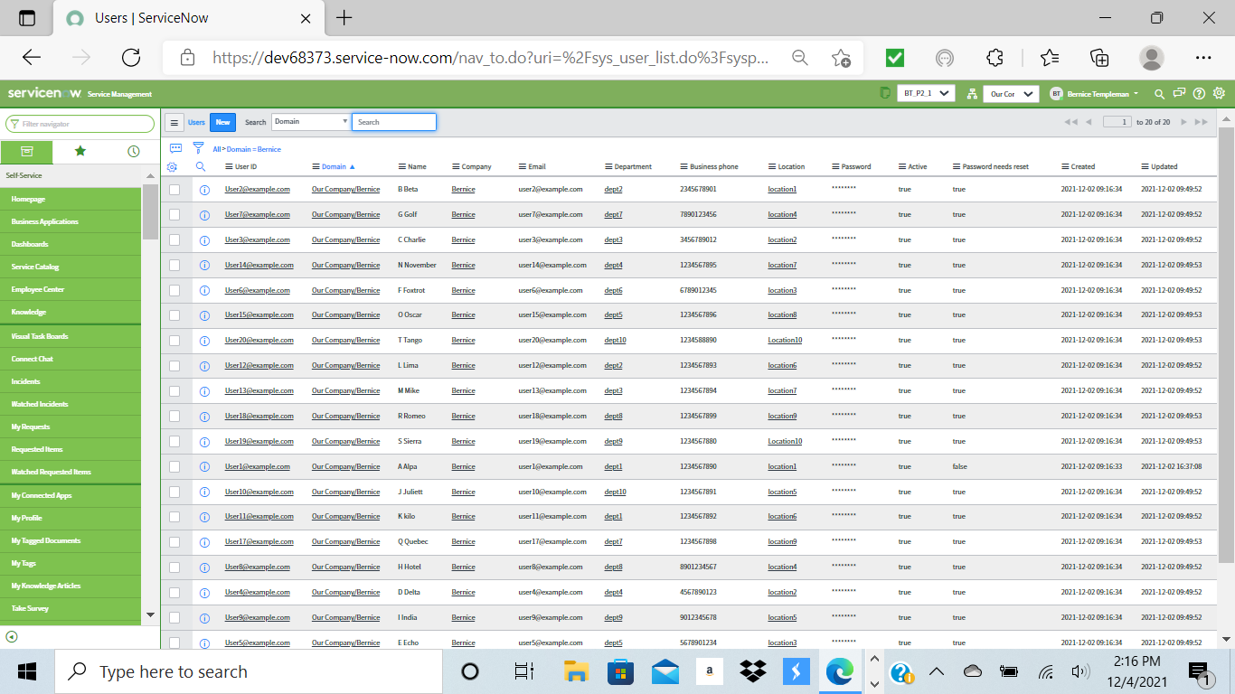
Users

Slide 26
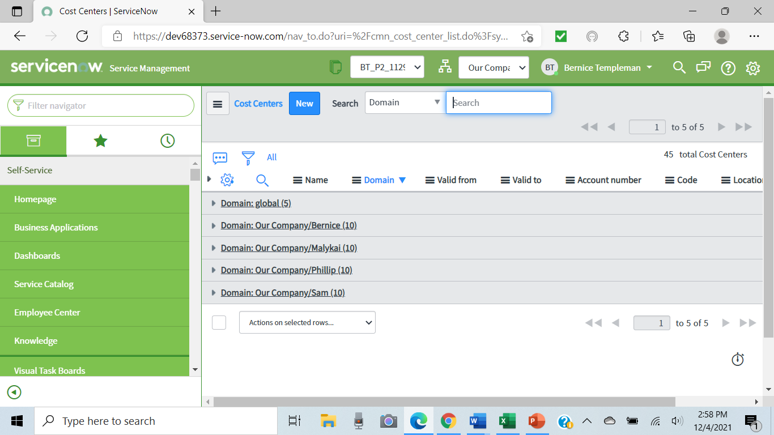
Cost Centers: cmn_cost_center

Slide 27
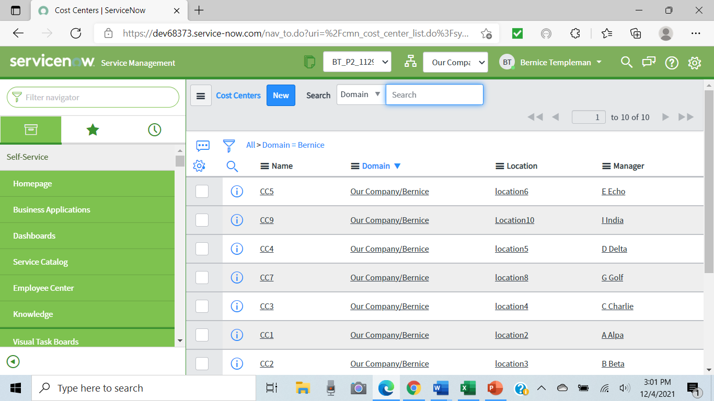

Slide 28
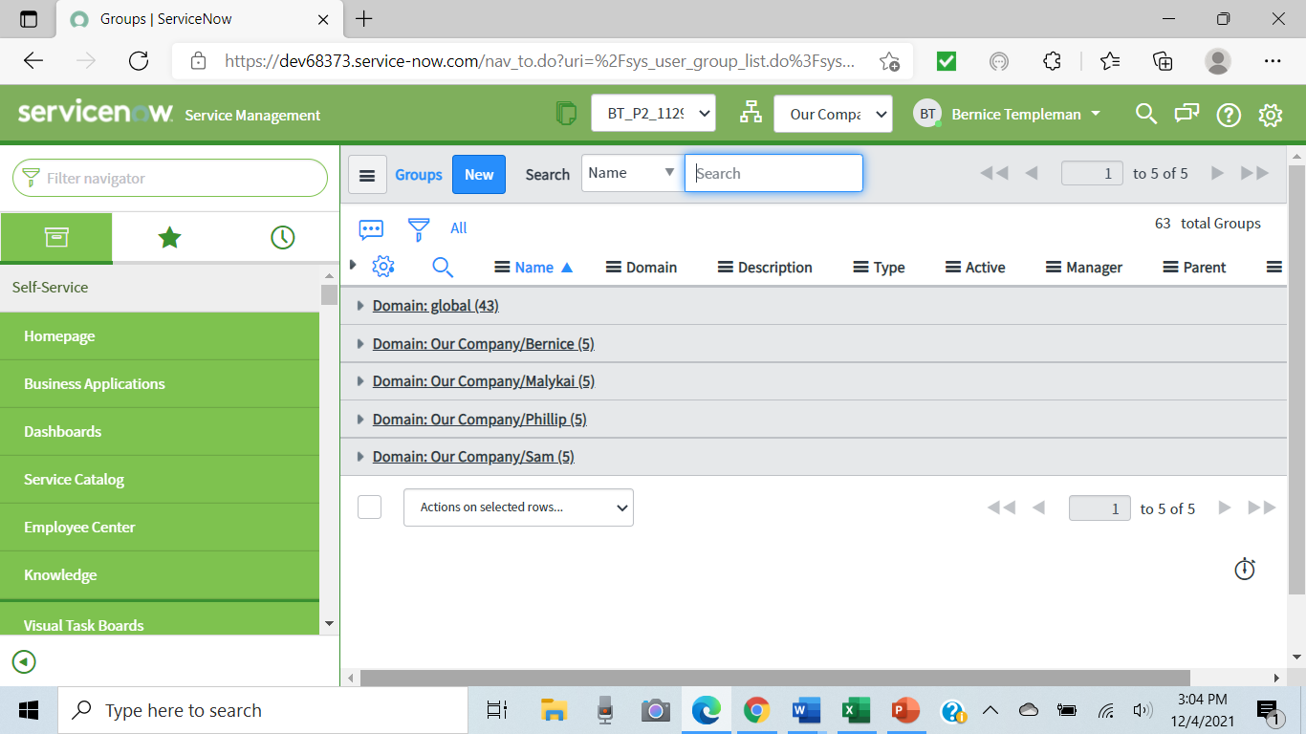
Groups: sys_user_group

Slide 29
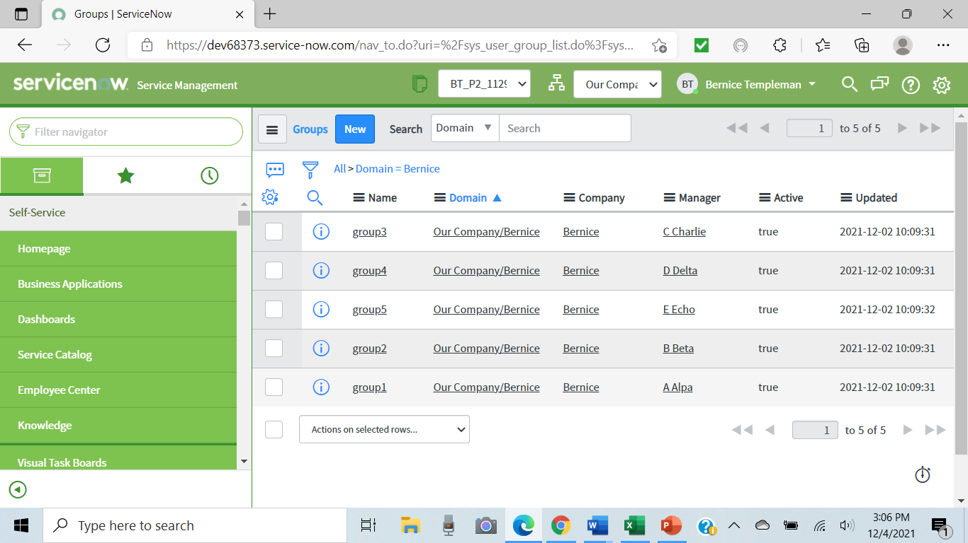
Groups

Slide 30
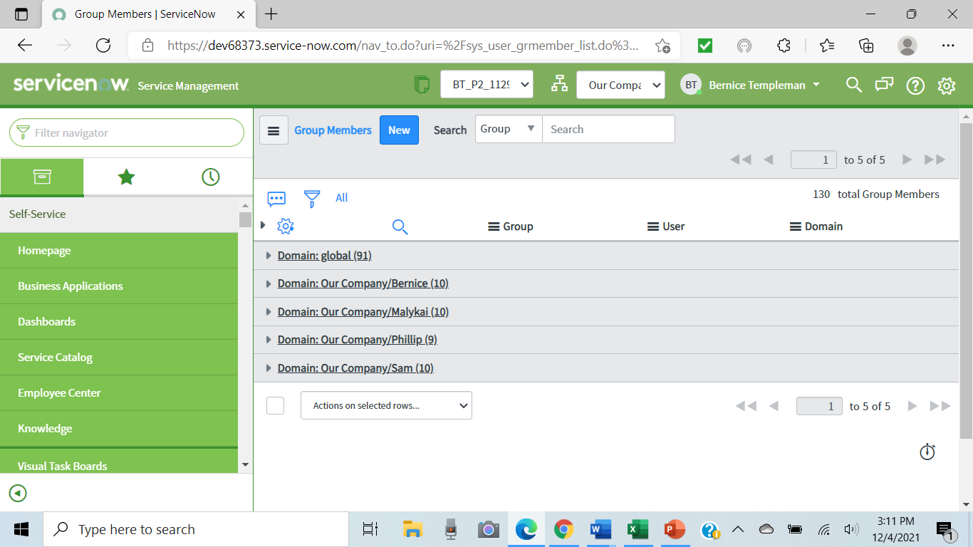
Group members: sys_user_grmember

Slide 31
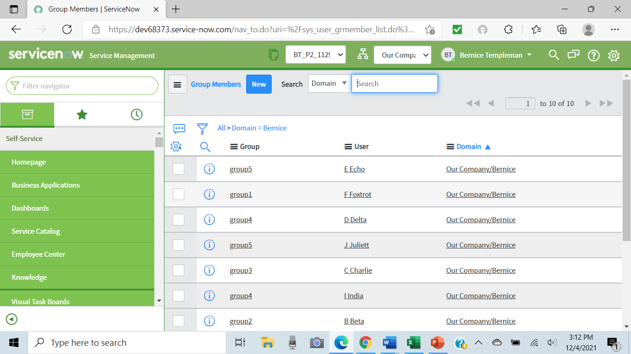
Group members

Slide 32
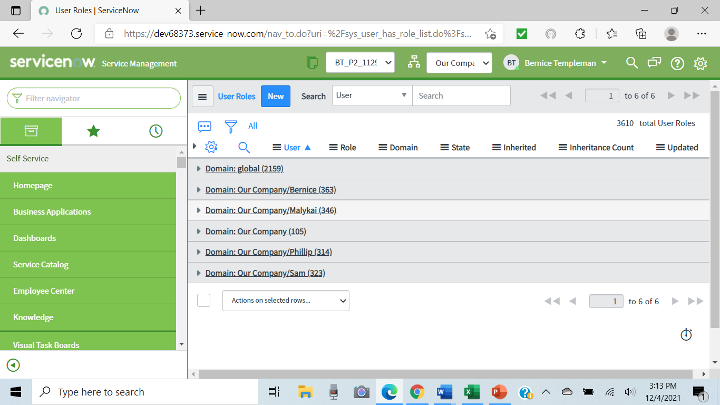
User Roles: sys_user_has_role

Slide 33
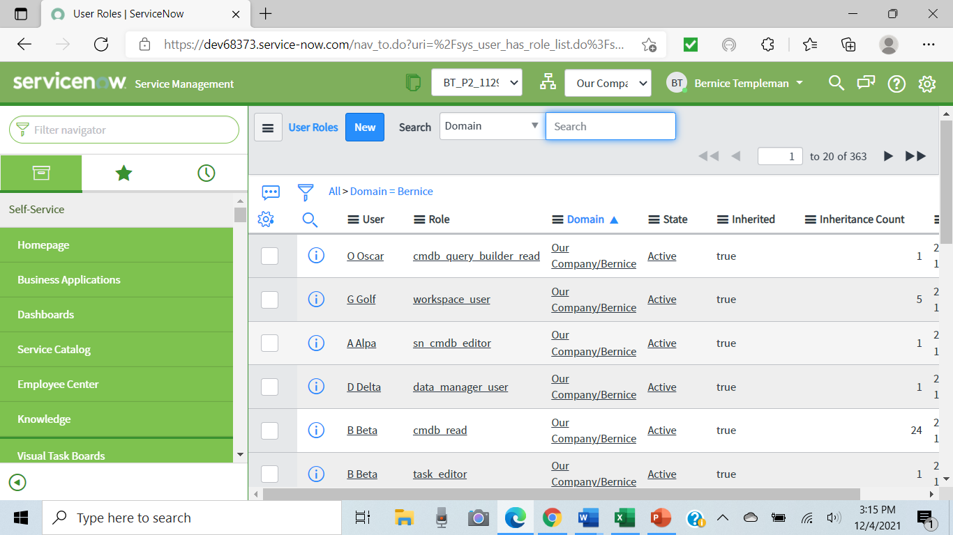
User Roles

Slide 34

Windows Servers: cmdb_ci_win_server

Slide 35
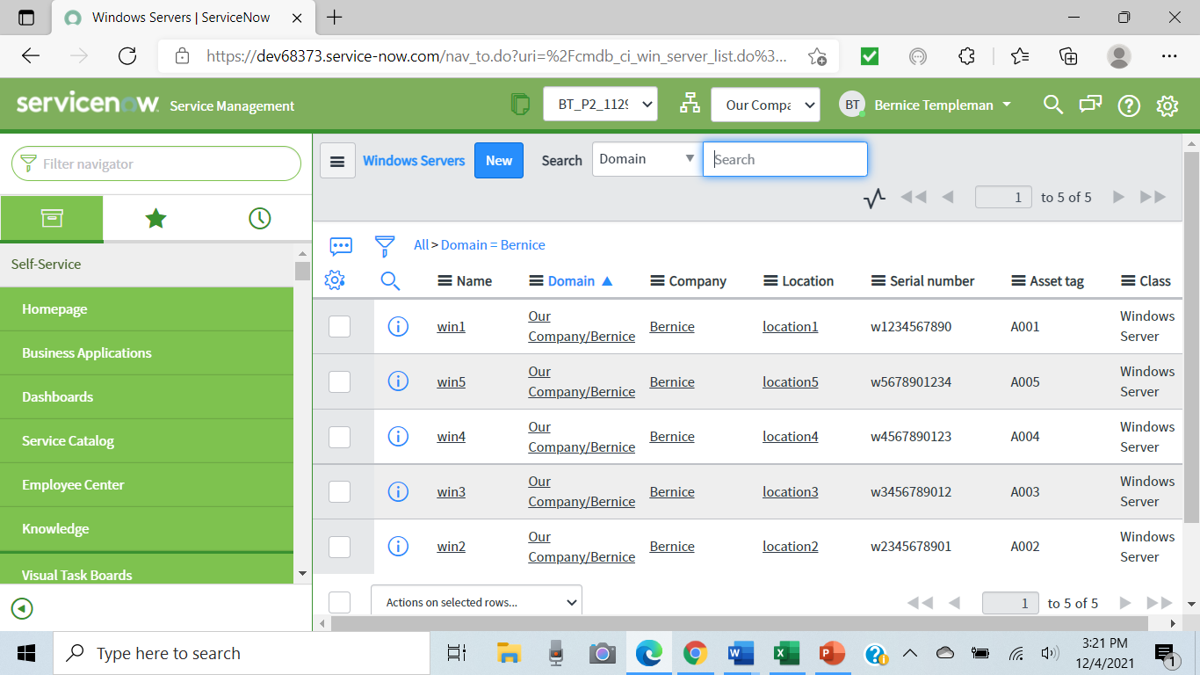
Windows Servers

Slide 36
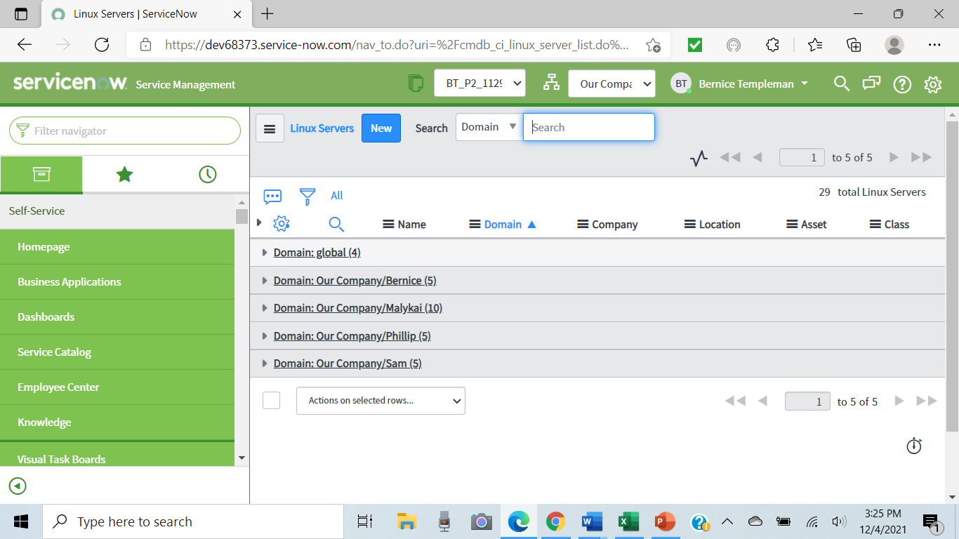
Linux Servers: cmdb_ci_linux_server

Slide 37
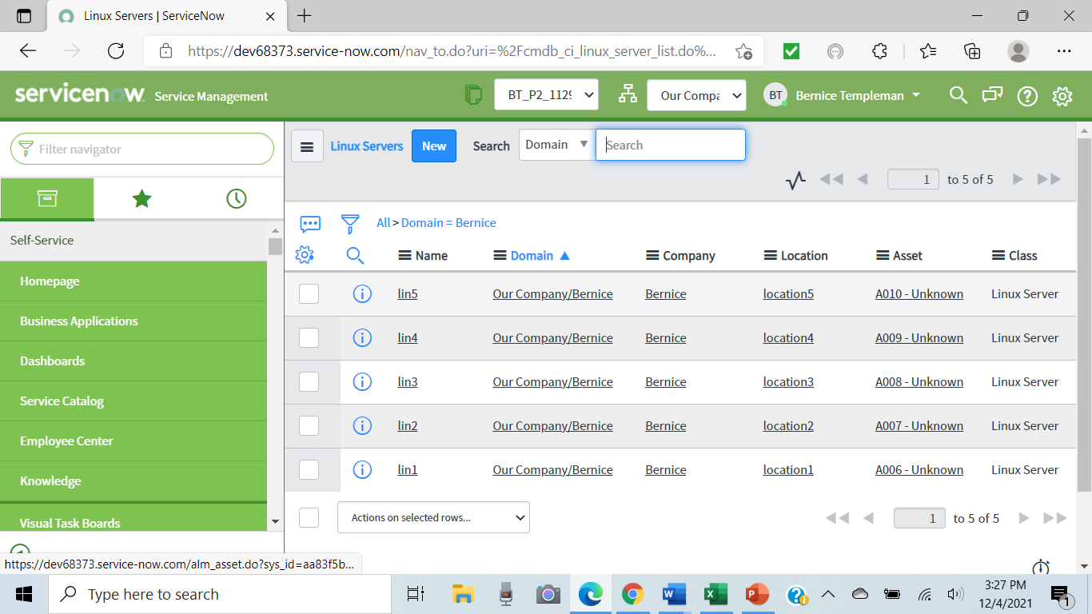
Linux Servers

Slide 38
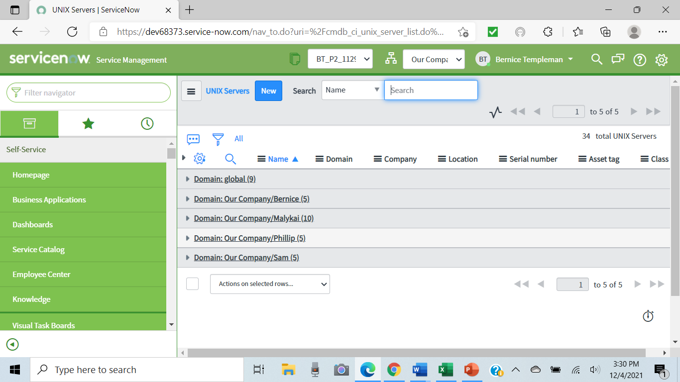
Unix Servers: cmdb_ci_unix_server

Slide 39
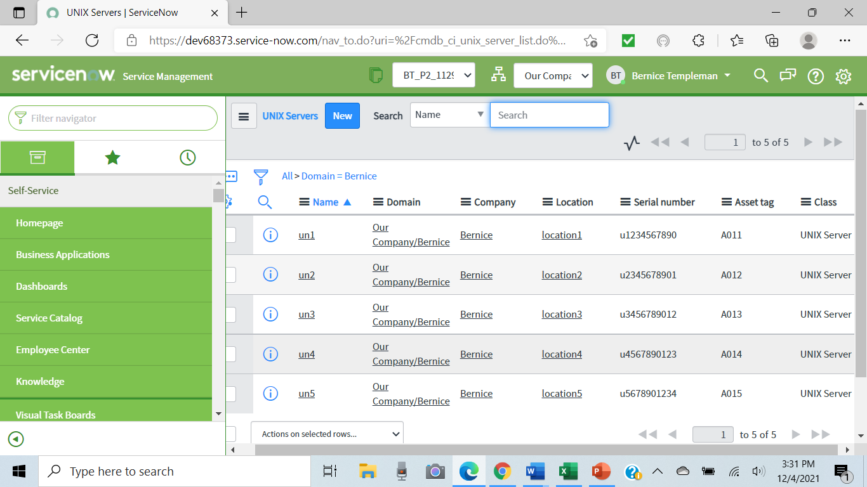
Unix Servers

Slide 40

Oracle/MySQL: cmdb_ci_database

Slide 41
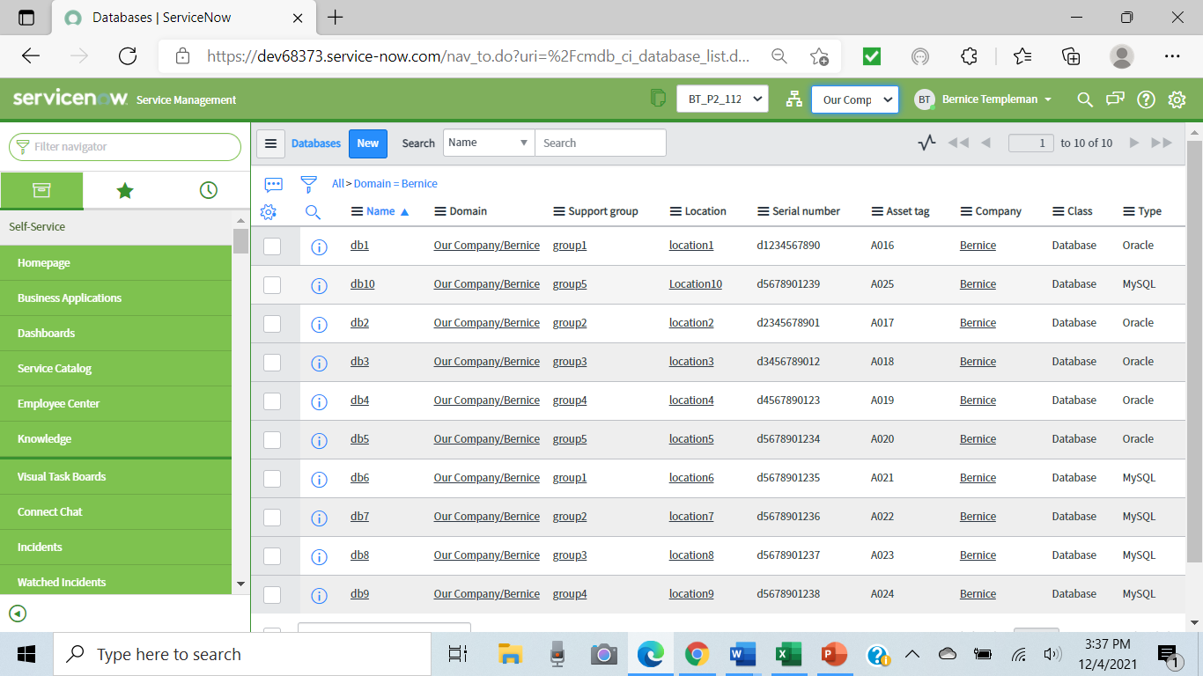
Oracle/MySQL

Slide 42
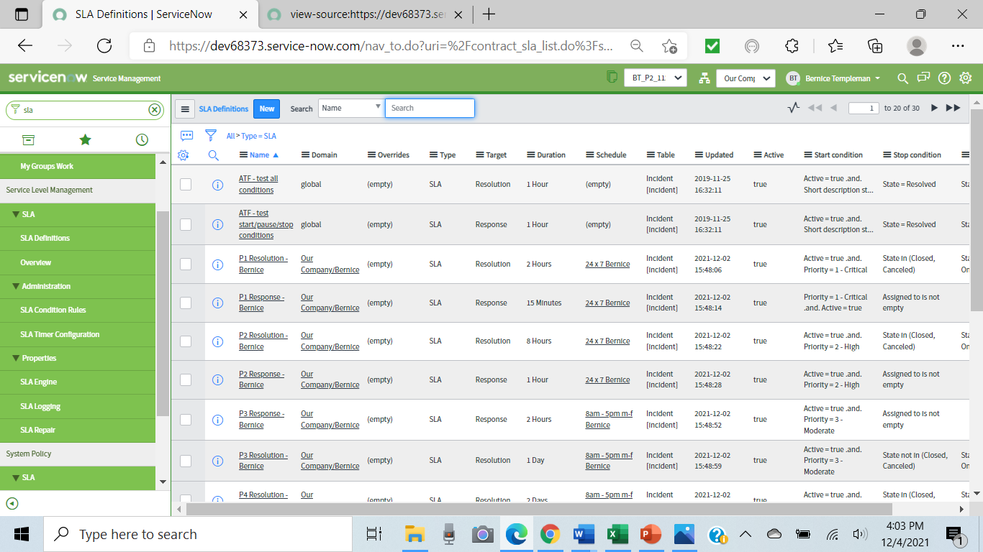
SLA: contract_sla

Slide 43
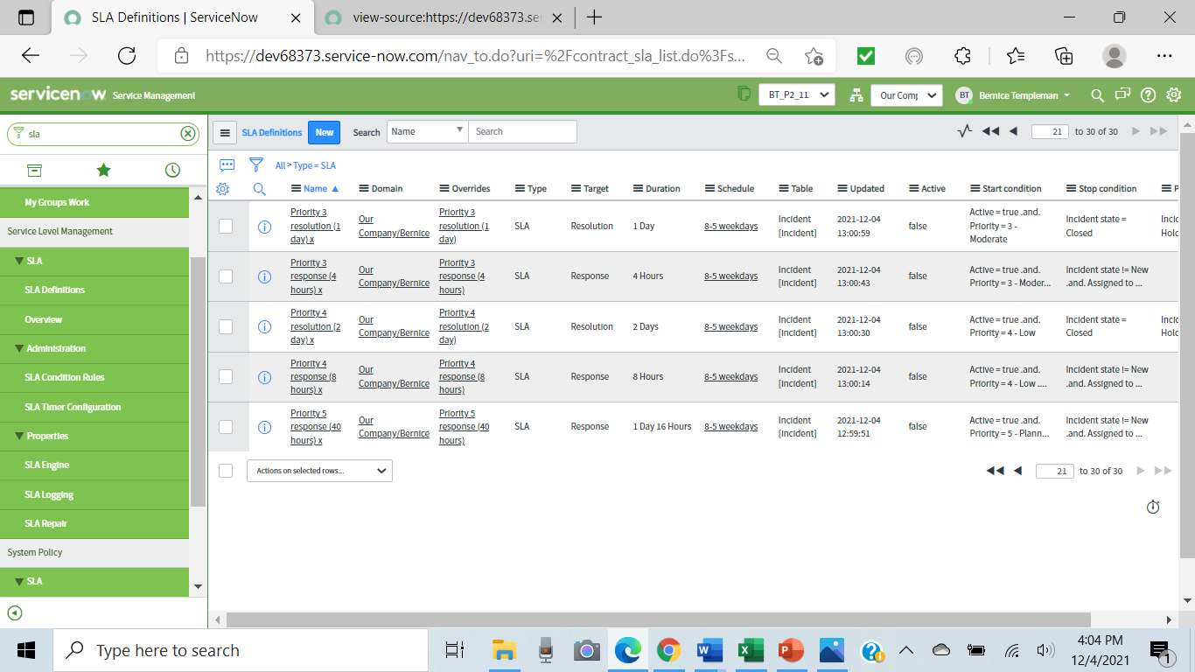

Slide 44
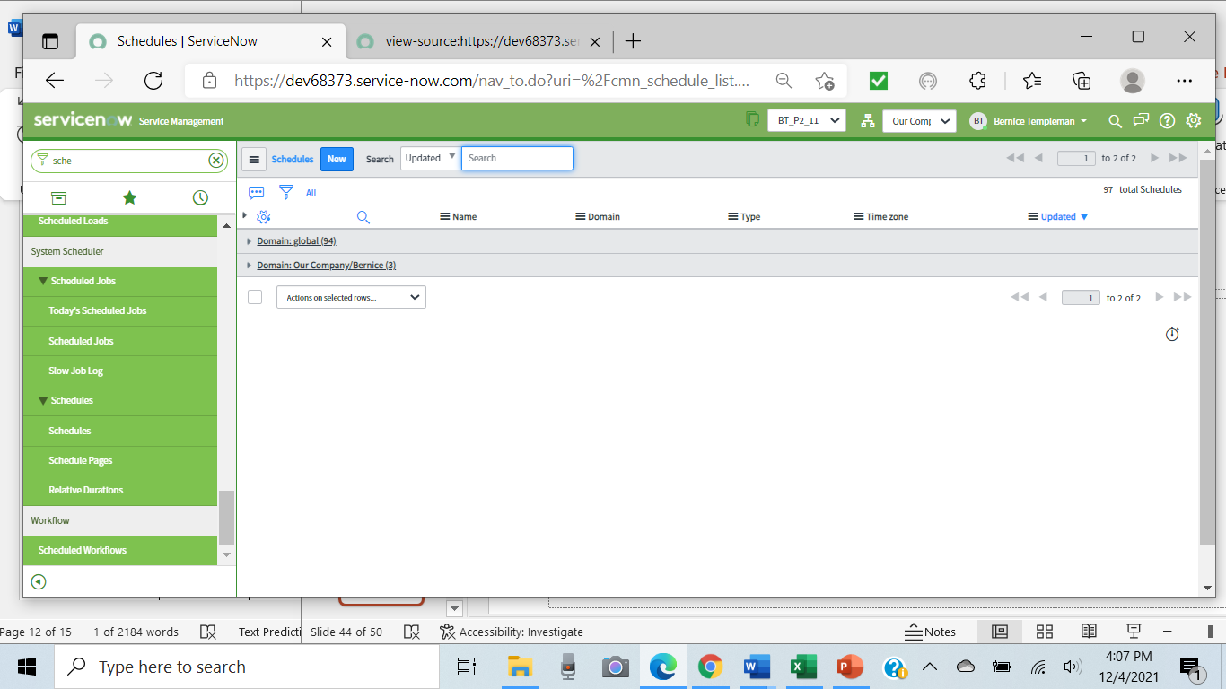
Schedules

Slide 45
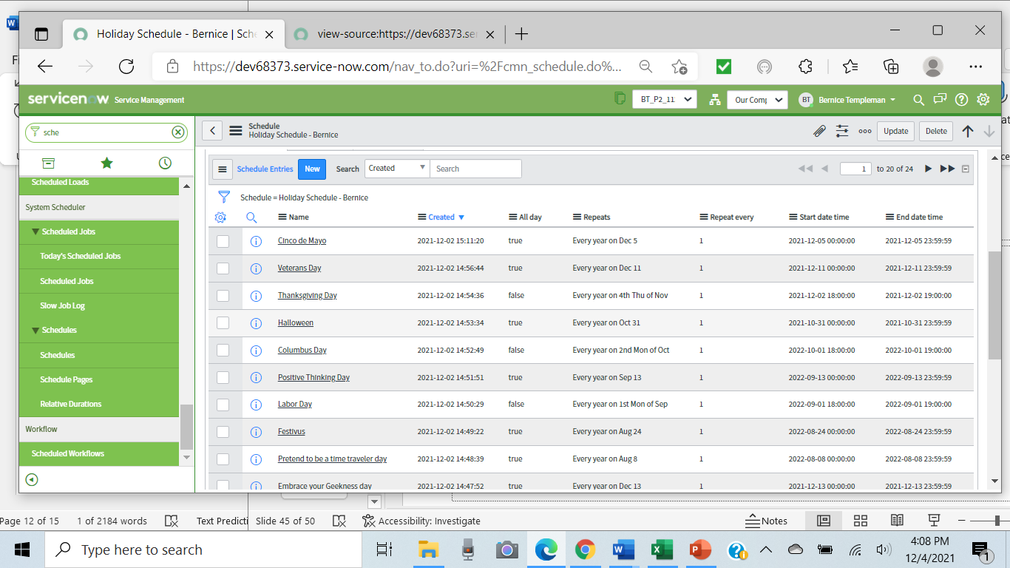
Holiday Schedule

Slide 46
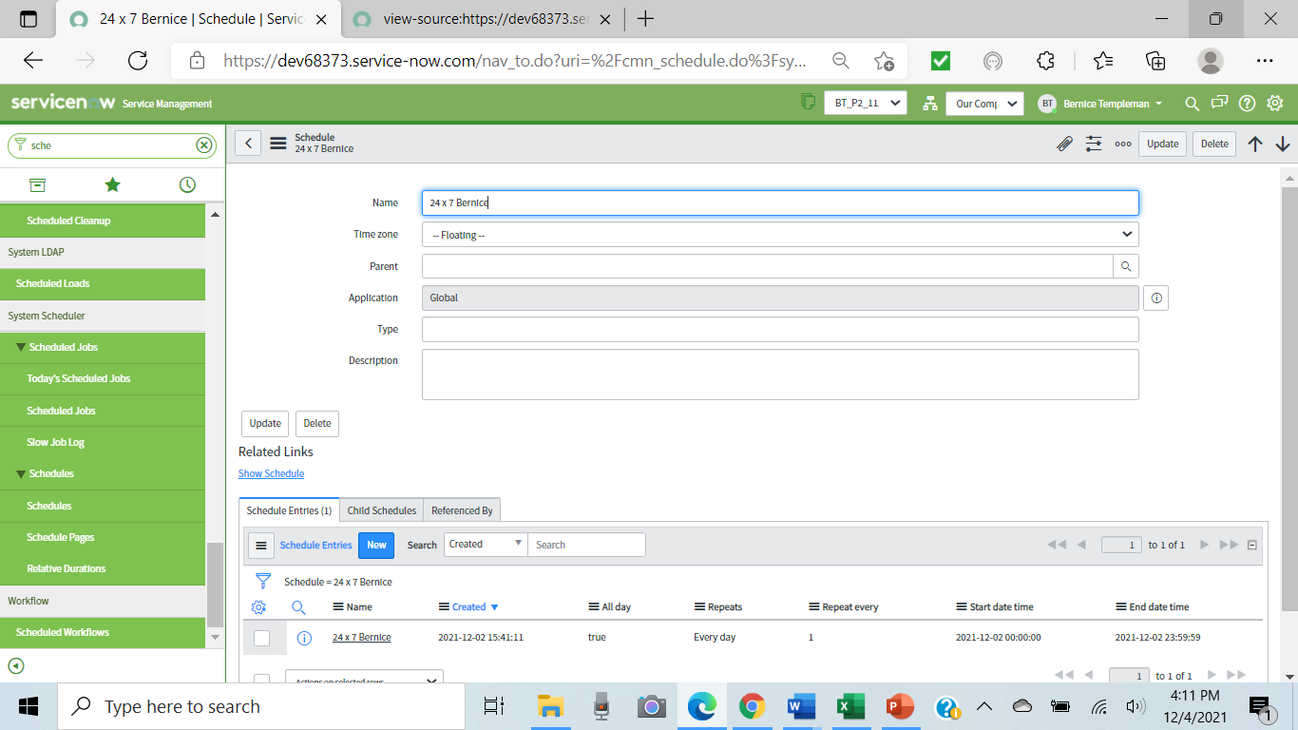
24 x 7

Slide 47
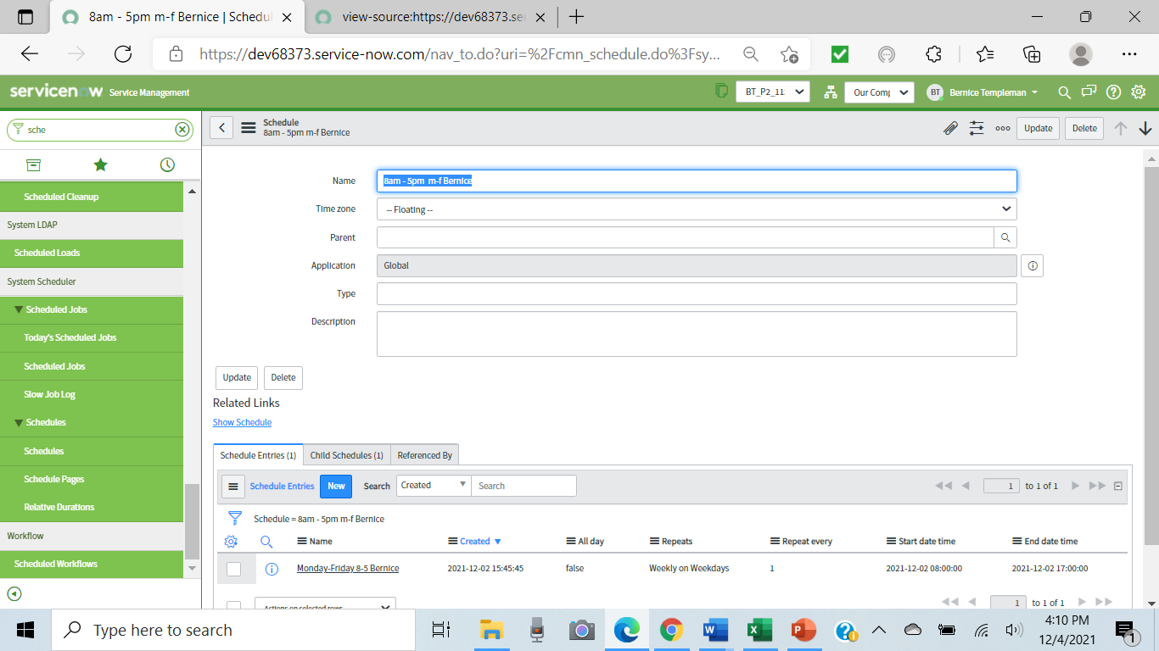

Slide 48
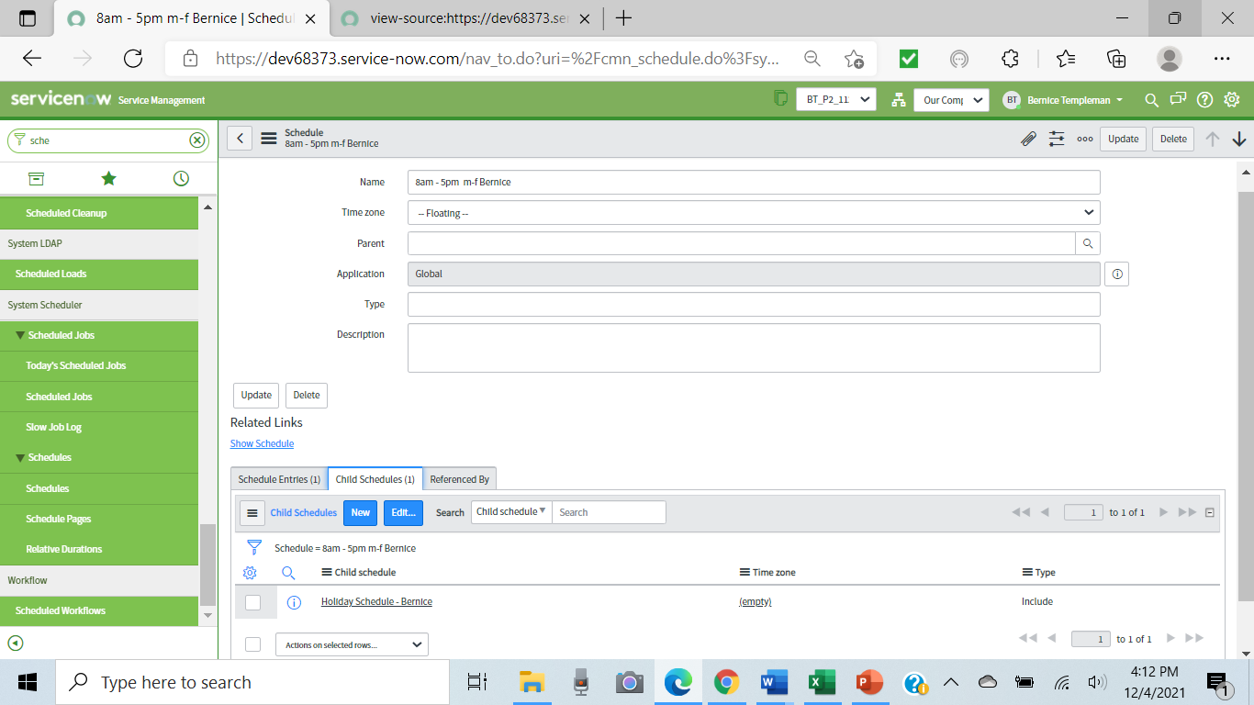
Holiday added for 8-5 m-f

Slide 49
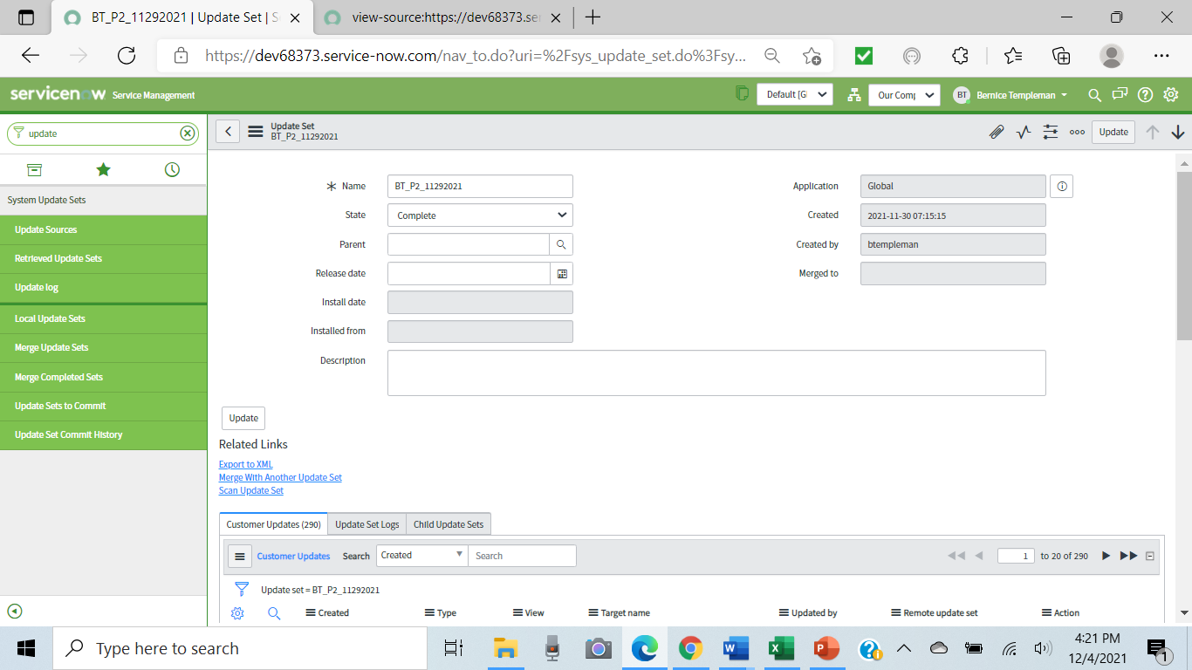
Complete update set

Slide 50
Reflections
Inaccurate data in Excel
Follow FRS for table names, fields, choice action and coalesce.
FRS: some listed variables are nor available to transform
Use email address (unique for user and domain/company) for user id to avoid any duplication

Slide 51
Questions?

Slide 52
Thank You

